Slide 1
JAD CA2
Presentation Deck

Slide 2
MVC Utilisation
Features that utilise MVC(s):
User:
Add item to shopping Cart
Managing items in the shopping Cart
Creating a successful order
Retrieving User Addresses, Updating User Addresses
Retrieving User Profile, Updating User Profile
Retrieving User Orders
Search User (Advanced?)
Retrieving Categories, Products (Advanced ?)
Reset Password (Advanced ?)
Verifying Login (Advanced ?)
Admin:
Adding a new Category
Adding a new Customer
Adding a new Product
Retrieving sitewide Orders
Deleting a Category
Deleting a Product
Search Product
Advanced : REST, Other features converted to MVC, Search Customer

Slide 3
MAIN FEATURES
MVC

Slide 4

Access Control (Two Tier)
Alerts controller of a particular event
Redirects to
/cartManagement servlet
Servlet retrieves the user’s session (Object that can access getter / setter methods) and verifies the following;
Utilises UserDetails value bean
Does the session exist?
What is the user type?
Controller checks for the following;
Administrator Page
Check user session (if exists)
Is the user a admin user? If isn’t an admin, fail the validation check
User Page
Check user session (if exists)
Is the user a registered / admin user? If neither, it fails the validation check.
Upon failing the validation check, the servlet assigns a redirect URL to the HomePage.jsp with the follow parameter(s);
error=notLoggedIn
error=unauthorised
These errors are then displayed in the front end via Javascript
CONTROLLER
View also checks if the user has access to this page. Same as how the servlet would verify.
VIEW
Controller re-renders the
View with latest Data
Sends Requests
User

Slide 5
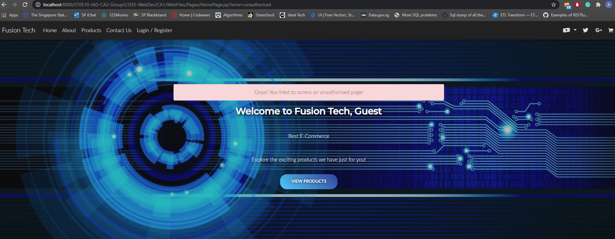
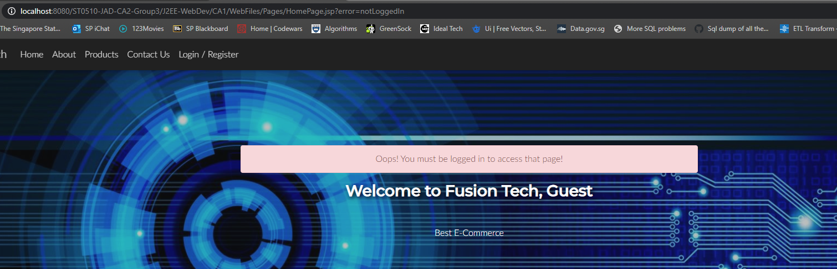
If users try to access the unauthorised page, these are the ‘error’ handlers

Slide 6
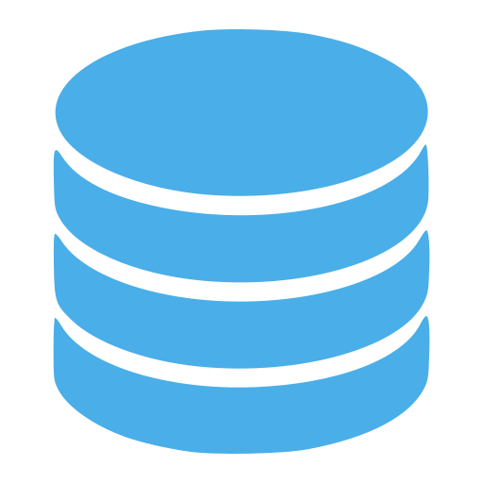
Shopping Cart - Adding Products (Create)
ShoppingCart object is used
DB
Controller updates the respective model based on event called
Method: addToShoppingCart
Parameter: Product Code, Current Cart, Qty to add
Alerts controller of a particular event
Redirects to
/addToShoppingCart servlet
Parameter:
Product Code
Quantity to add
Currency (SGD, MYR, USD)
CONTROLLER
Pings the database and then gets the latest data of the product that is being added to cart.
VIEW
MODEL
Controller re-renders the
View with latest Data
Gathers data & store in cartList array.
If there is an existing cartList, the model adds on to it rather than replacing it.
Finally, the arrayList is returned
Sends Requests
Request: Add product to cart
User

Slide 7
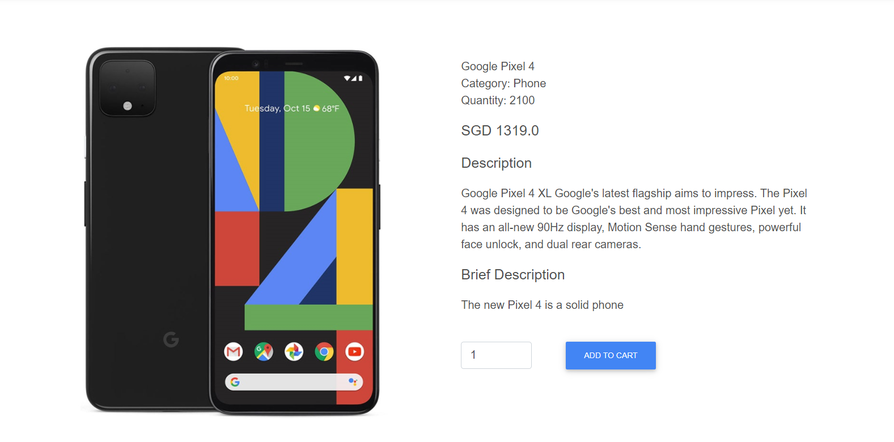
Shopping Cart (Adding Products)
Add to cart button at the bottom right.
Input field for user to key in the quantity of the purchase.

Slide 8
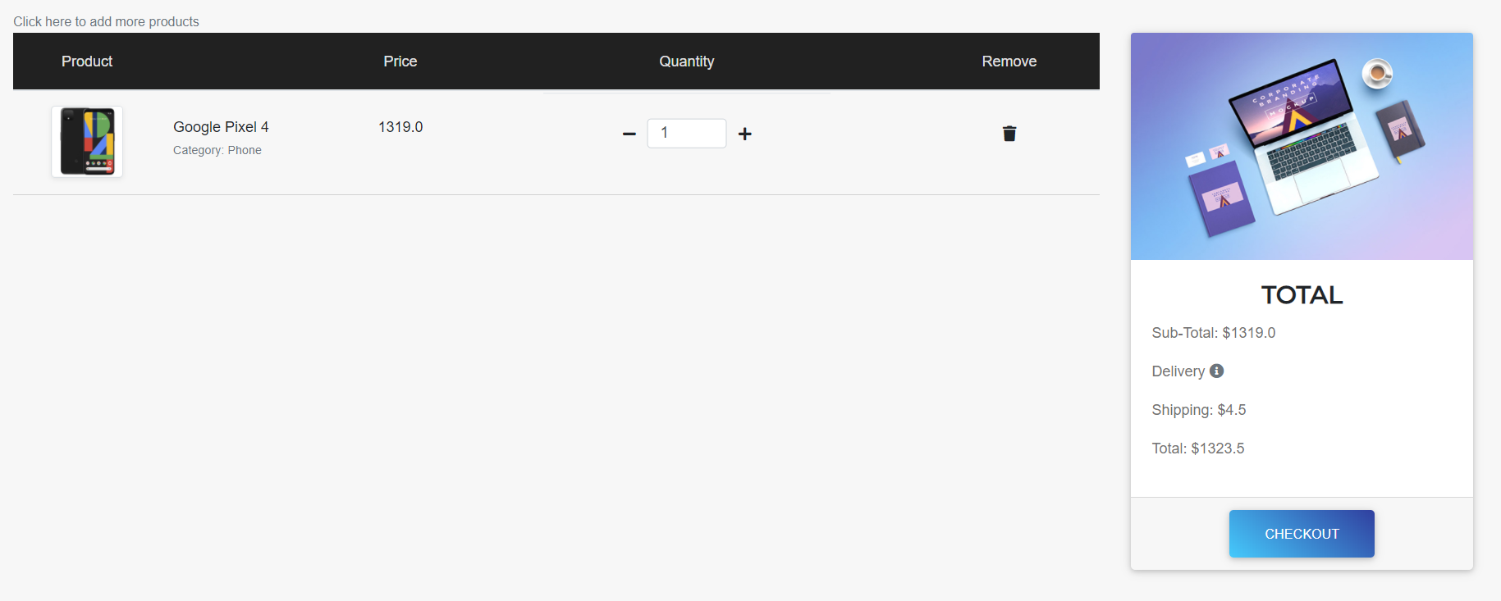
Shopping Cart (Adding Products)
When the add to cart button is clicked, the user will be redirected to the shopping cart list.

Slide 9
Shopping Cart - Managing Products (Update + Delete)
Alerts controller of a particular event
Redirects to
/cartManagement servlet
Parameter:
User Action
Product Index (ArrayList Index)
No model is called as the adjustment of Quantity is done through the arrayList titled as ‘cartList’
So how does the controller handle the actions?
If user wants to add quantity, it verifies if the quantity increment (Always increments by 1) will exceed the quantity in stock for the product. If it does, do not update, set the redirectURL with a error in the parameter.
If user wants to remove quantity, it verifies if the quantity decrement (Always decrements by 1) will go below 1. If it does, do not update, set the redirectURL with a error in the parameter.
If user wants to delete a product, it gets the array index list and removes it from the cart ArrayList. If removing the product means the cart will be empty, it removes the cart arraylist session.
Array is updated, servlet redirects back to the View with the latest data (Session)
CONTROLLER
VIEW
Controller re-renders the
View with latest Data
User Action:
Delete
AddQty
RemQty
Sends Requests
Request: Add product to cart
User

Slide 10
Shopping Cart (Managing Products)
When the + icon is clicked, the quantity increases.
Total cost on the right also increases accordingly base on the total cost.

Slide 11
Shopping Cart (Managing Products)
When the - icon is clicked, the quantity decreases.
Total cost on the right also decreases accordingly base on the total cost.

Slide 12
Shopping Cart (Managing Products)
When the remove icon is clicked, the product is removed from the cart.

Slide 13
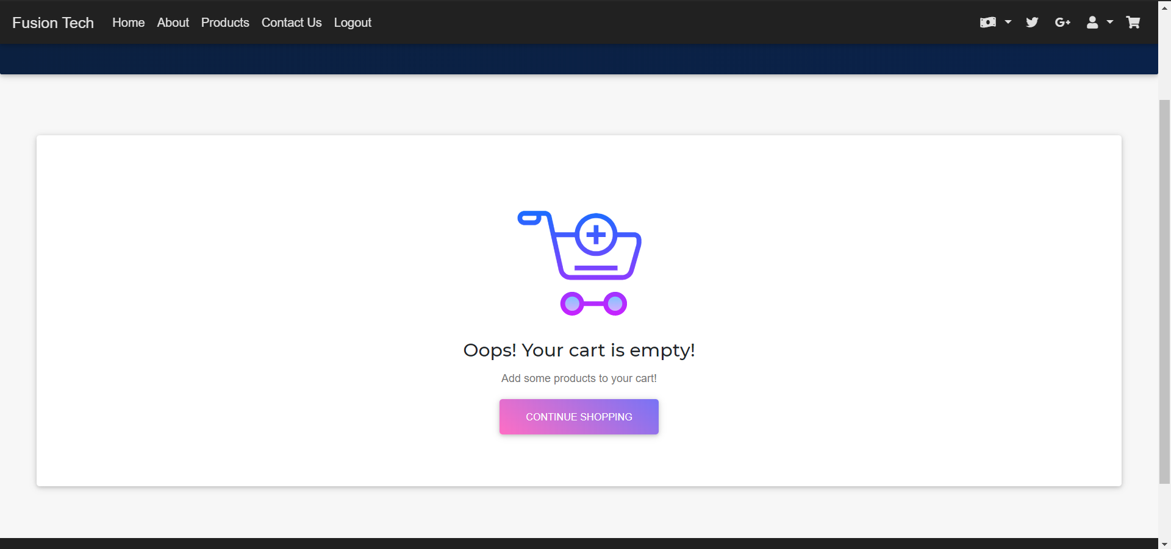
Shopping Cart - Empty Cart
When there are no items in the cart,
Users will be prompted to purchase something.

Slide 14
Checkout
Model: addCustomerOrderInformationToDB.java
Method(s):
addOrderShipping / addOrderBilling
addOrder
Model: AddCartItemsToOrder.java
Method(s):
getShippingIndex / getBillingIndex
getOrderDetails
orderItemsToCart
DB
UserDetails, ShoppingCart , UserAddresses and orderDetails object are used
Controller performs verification of card number and verification of card expiry.
This is in addition to the
Javascript verification.
Alerts controller of a particular event
Redirects to
/createCustomerOrder servlet
Parameter:
Payment Details
Shipping Details
Billing Details
Pings the database and then gets the latest data of the indexes for the other methods and inserts data for the respective order & its items
CONTROLLER
If verification fails, it, stores the session of the checkout information for an easier checkout.
VIEW
MODEL
Controller re-renders the
View with latest Order Data that is stored via Session
It will return a boolean value that is passed into the Controller which then allows it to verify if a particular section of the order has been inserted successfully.
It also sets an orderDetail object which the controller can use.
Sends Requests
Request: Submit Checkout
User

Slide 15
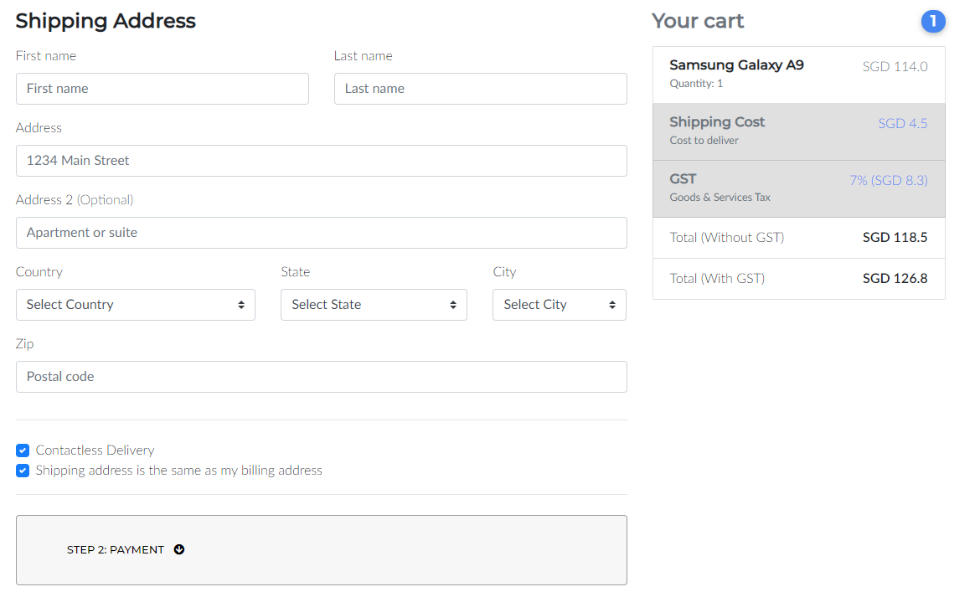
Shopping Cart Checkout Page/Form
User will be brought to the checkout page.
Final cost with GST and no GST will be displayed, along with the item in the cart
Users can opt in / out of contactless delivery
If users decide to have different shipping and billing address, they can uncheck the box which will open a new form as seen in the next slide

Slide 16
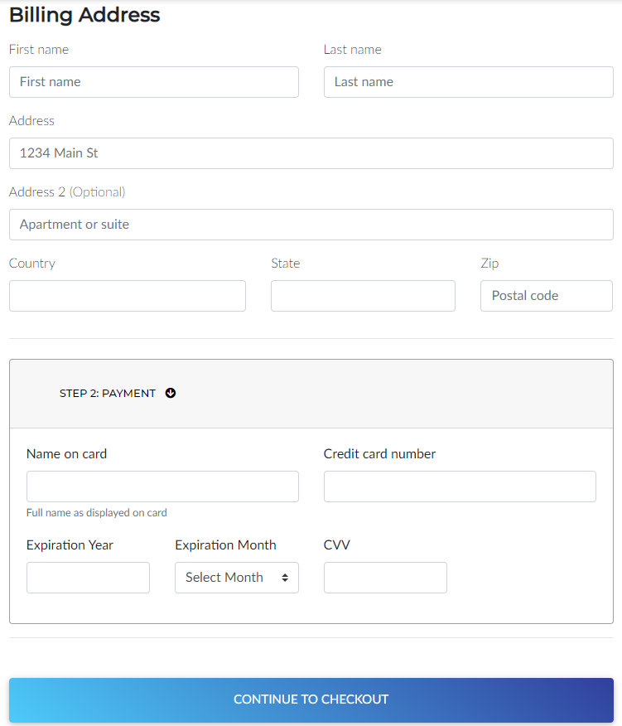
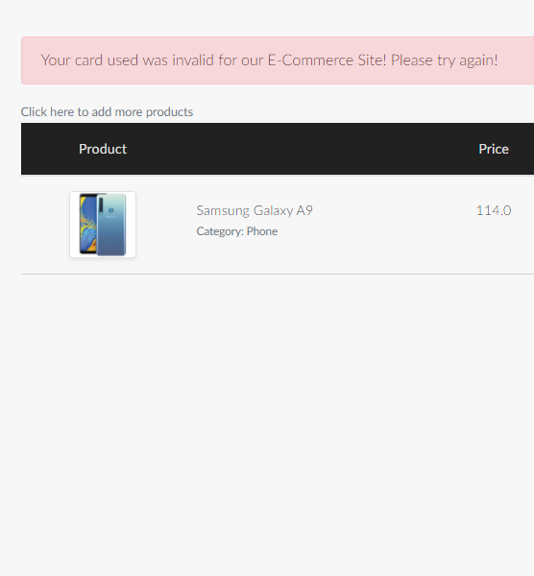
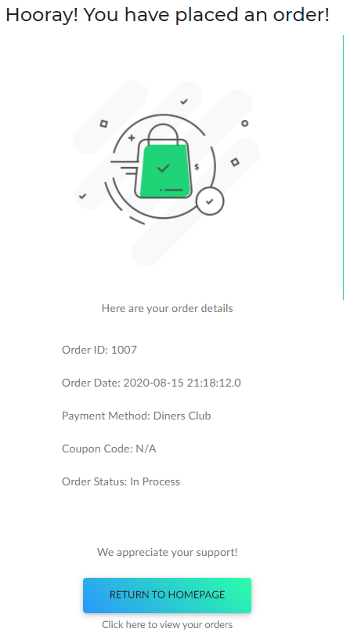
The payment details are verified by Javascript as well as in the Servlet
On clicking continue to checkout, it will redirect to the servlet for processing

Slide 17
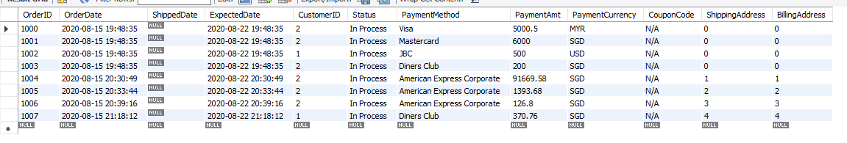
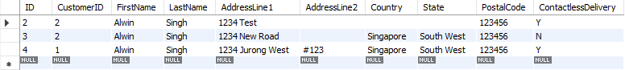
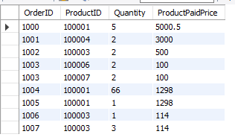
Database capturing orders

Slide 18
User Addresses
DB
UserDetails & UserAddresses object are used
Controller updates the respective model based on event called
Object: UserAddresses
Model: UserAddressesFromDB
Parameter: User ID
Alerts controller of a particular event
Redirects to
/getUserAddresses servlet
CONTROLLER
Pings the database and then gets the latest data of user’s addresses
Controller re-renders the
View with latest Data by updating the Session ‘addressList’ with the latest arrayList from the model
VIEW
MODEL
Gathers data & store in addressList array. This array is based off the UserAddresses object. (Allows for GET / SET Methods)
End of execution, the arrayList (‘addressList’) is returned
Sends Requests
Request: View Address
User

Slide 19
Update User Addresses
DB
Controller updates the respective model based on event called
Object: UserAddresses
Model: UserAddressesFromDB
Method:
updateUserAddressesToDB
Alerts controller of a particular event
Redirects to
/UpdateUserAddresses servlet
Parameter:
Gets Form Action (Update / Delete)
Gets the form values (Address information)
CONTROLLER
Pings the database and then updates the address data
Controller redirects to another Controllers that updates the session ‘addressList’ and redirects to the view.
VIEW
MODEL
The Method #1 above returns a Boolean value. This is after it pings the Database and updates the user’s address in the DB.
In the controller, if true, it redirects to the /getUserAddresses servlet so that it can reload the list of Addresses. Otherwise, it redirects to the editUserAddresses.jsp with an error in the parameter.
Sends Requests
Request: Update Address
User

Slide 20
Delete User Addresses
DB
Controller updates the respective model based on event called
Object: UserAddresses
Model: UserAddressesFromDB
Method:
deleteAddressFromDB
Alerts controller of a particular event
Redirects to
/UpdateUserAddresses servlet
Parameter:
Gets Form Action (Update / Delete)
Gets the address database index from the form submitted
CONTROLLER
Pings the database and then updates the address data
Controller redirects to another Controllers that updates the session ‘addressList’ and redirects to the view.
VIEW
MODEL
The Method #1 above returns an integer (delete count). If it is more than 0, it means successful else unsuccessful. This is after it deletes the user’s address in the Database.
In the controller, if the method returns a success ( > 0), we redirect to the /getUserAddresses servlet else it redirects to the editUserAddresses.jsp with an error in the parameter.
Sends Requests
Request: Delete Address
User

Slide 21
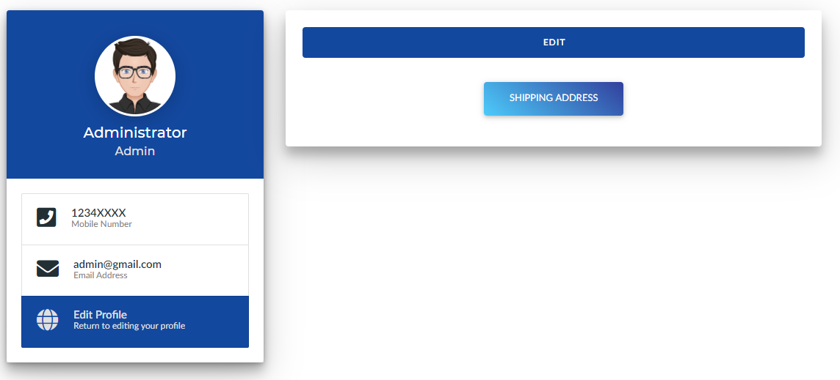
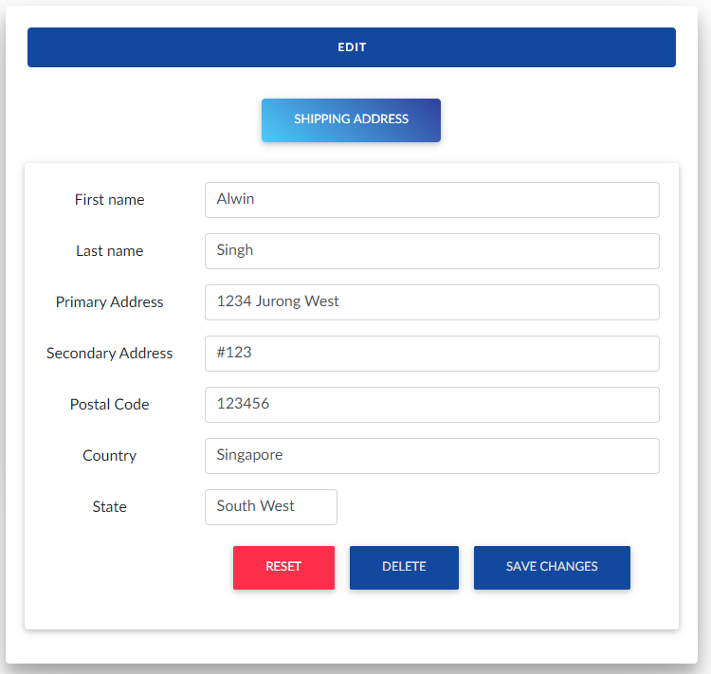
The buttons redirect to the servlet to update the Addresses or to Delete them.
The reset button does not redirect to the servlet but just resets the form to its original input

Slide 22
User Orders
Controller updates the respective model based on event called
Object: OrderDetails
Model: UserOrdersFromDB
Method:
getOrdersFromDB
getOrderItemsFromDB
getAddressListForOrdersFromDB
DB
allProducts, UserDetails & OrderDetails object are used
CONTROLLER
Alerts controller of a particular event
Redirects to
/getUserOrders servlet
Pings the database and then gets the latest data of user’s orders
Controller re-renders the
View with latest Data by updating the Session ‘ordersList’, ‘orderItemsList’, ‘orderShippingInfoList’ with the latest arrayList from the model’s methods
VIEW
MODEL
Method 1 Execution: Returns an ArrayList of OrderDetails object that contains all the Orders
Method 2 Execution: Returns an ArrayList of allProducts object that contains all the products
Method 3 Execution: Returns an ArrayList of UserAddresses object that contains all the Order’s Addresses that are in use
Sends Requests
Request: View Orders
User

Slide 23
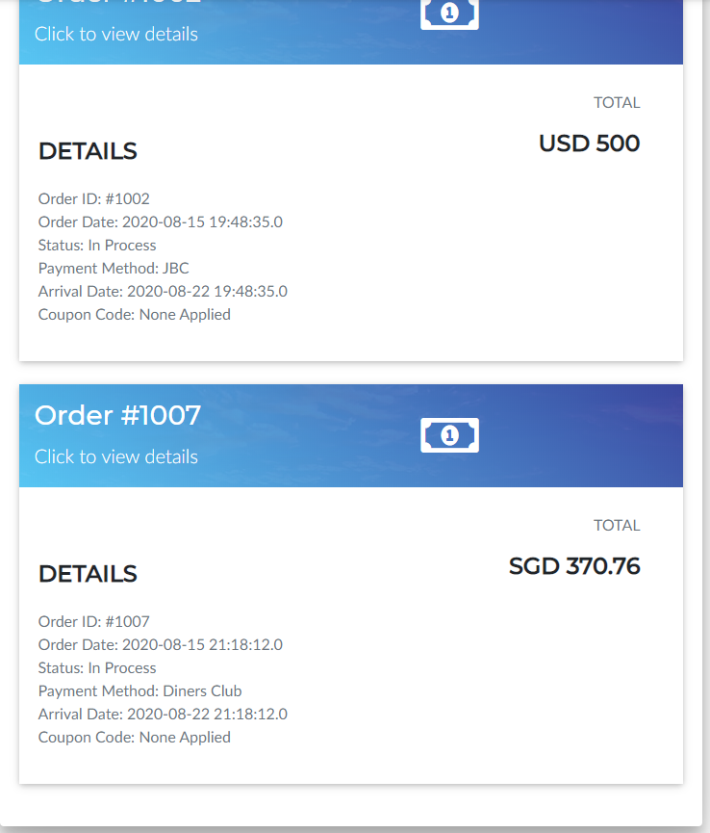
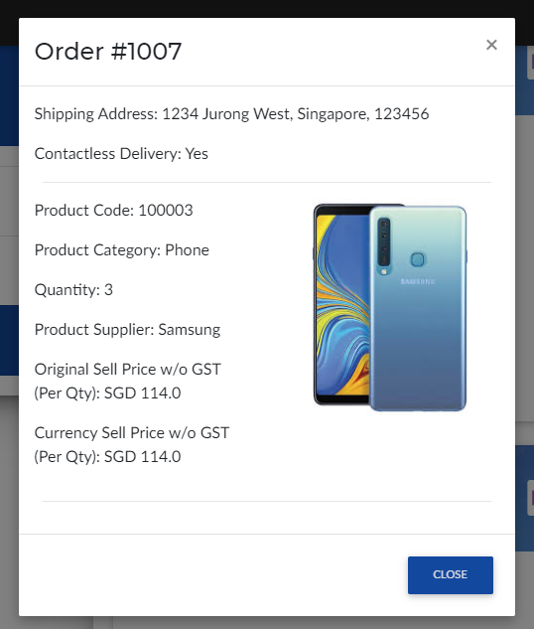
The order card shows the basic details.Upon clicking it will open up a modal that displays the order details.

Slide 24
User Profile
Controller updates the respective model based on event called
Object: OrderDetails
Model: processEditProfileDB
Method:
updateUserToDB
DB
UserDetails object is used
CONTROLLER
Alerts controller of a particular event
Redirects to
/updateUserProfile
servlet
Pings the database and updates the user’s data with the latest changes
Controller re-renders the
View with latest Data by updating the Session of the user’s data. It redirects back to the edit profile page
VIEW
MODEL
Method 1 Execution: Takes in the form parameters such as the user’s city, address, etc and updates it to the Database. It then returns a user details object.
Sends Requests
Request: View Orders
User

Slide 25
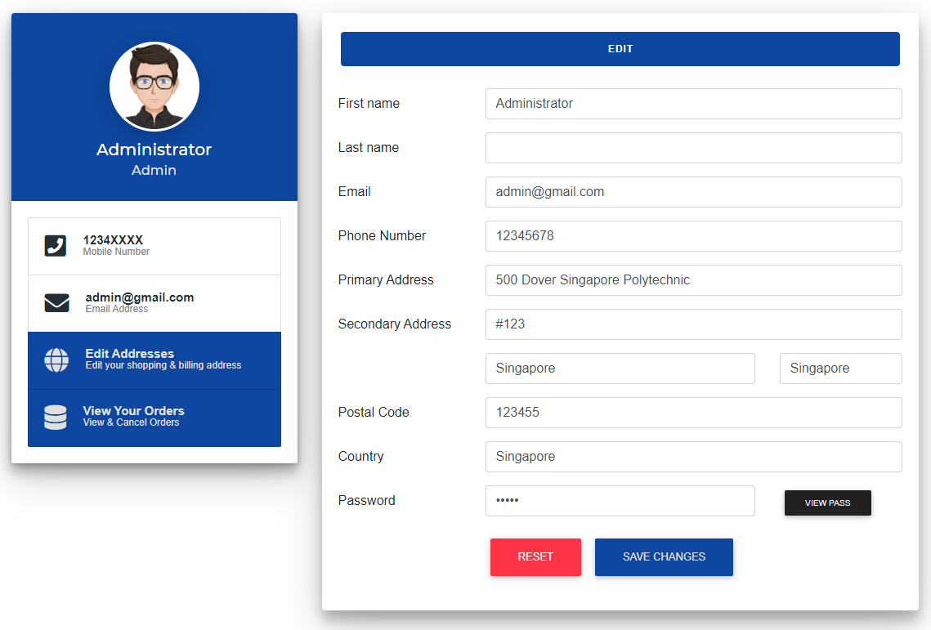
The button redirects to the servlet to update the customer’s information by overwriting the session after calling the utility bean
The reset button simply resets the form input to its original data

Slide 26
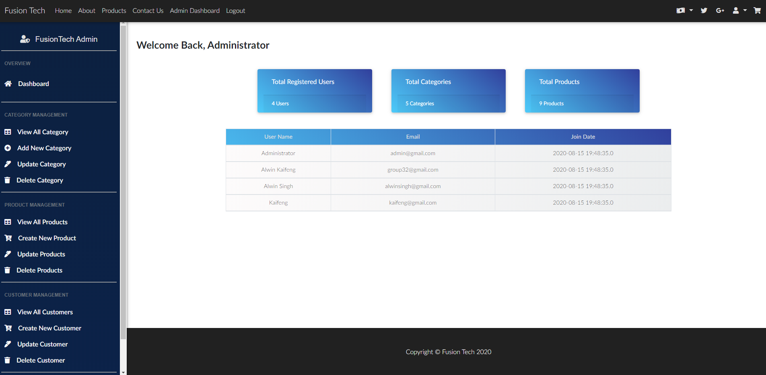
ADMIN

Slide 27
Admin Product Management (Get, Inquire & Report)
DB
Controller updates the respective model based on event called
Model: getInquireReportProductsFromDB.java
Selects product information from the database
Alerts controller of a particular event
Redirects to ../../../../adminGetAllProducts
Gets the parameter of the button value & page number to display correct table.
CONTROLLER
Pings the database and then gets the data base on table type.Sets the all Products getter/setter
VIEW
MODEL
Controller re-renders the
View with latest Data received from the attribute and redirects back to AdminViewAllProducts.jsp
Gathers data & store in productsList array.
productsList attribute is then set with the array.
Sends Requests
Request: View All Products
User

Slide 28
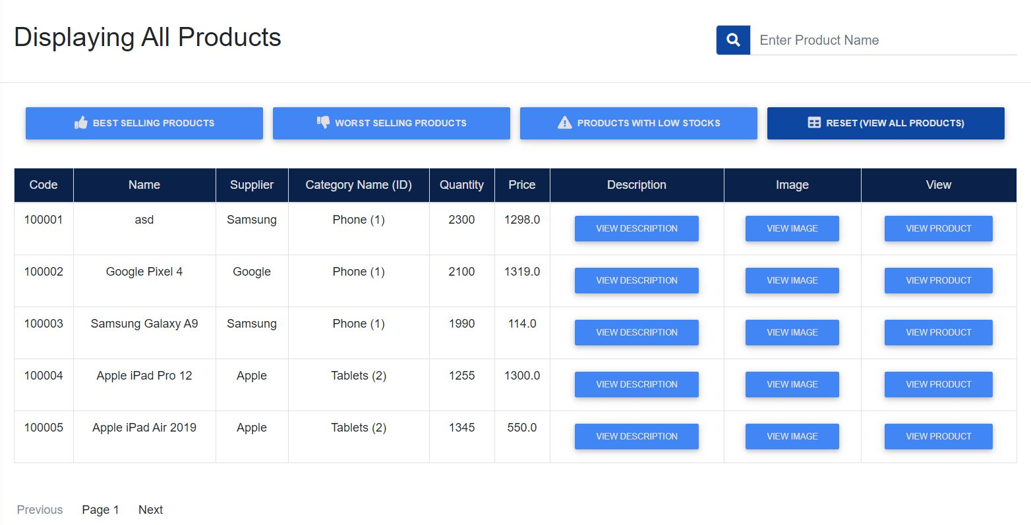
Admin Product Management (Get, Inquire & Report)
Gets the table in rows of 5.
Displays product information, image and viewing the product page.

Slide 29
Admin Product Management (Get, Inquire & Report)
Sets the type of table to display.
By default, table will be set to view all products.

Slide 30
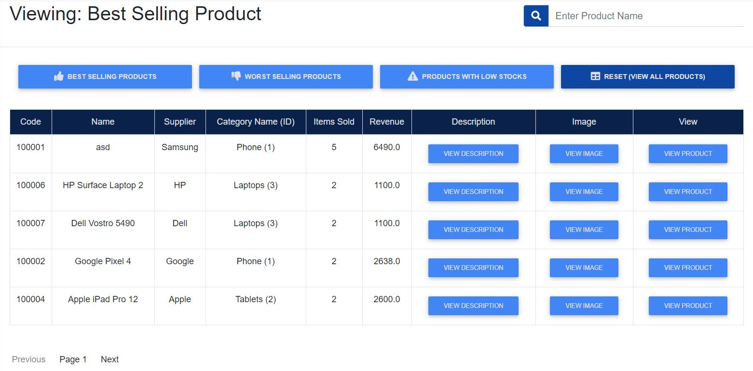
Admin Product Management (Get, Inquire & Report)
When best selling product is clicked, it displays the best selling products based on quantity

Slide 31
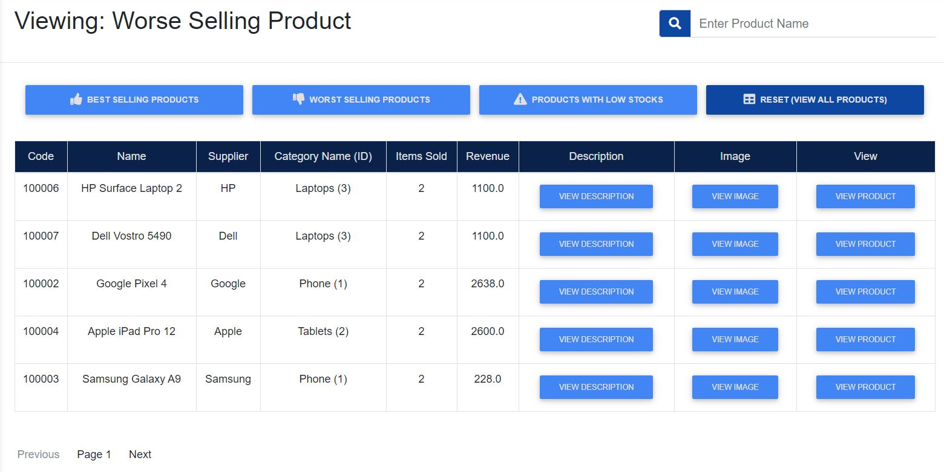
Admin Product Management (Get, Inquire & Report)
When best selling product is clicked, it displays the worst selling products based on quantity

Slide 32
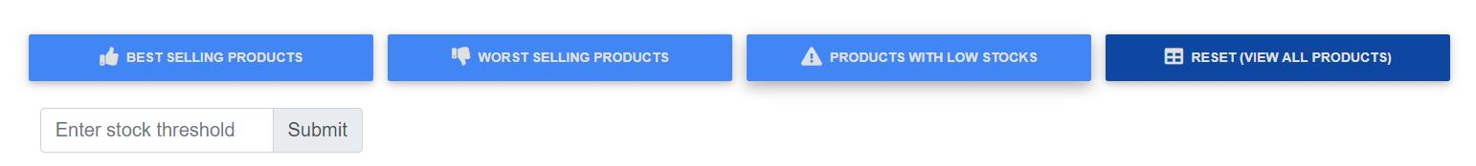
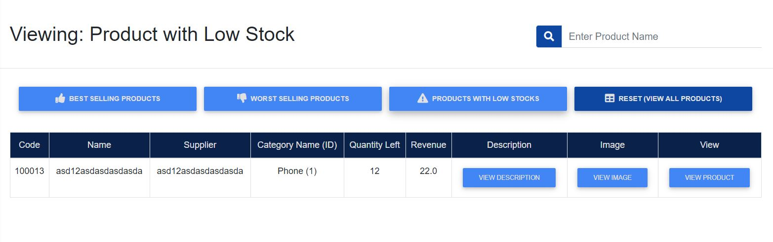
Admin Product Management (Get, Inquire & Report)
When products with low stocks is clicked, the stock threshold is displayed.
User is to type in the amount that they define as low stock.
Amount with quantity lower than the amount will be displayed
Result on the right display product with less than 500 quantity

Slide 33
Admin Product Management (Search Products)
DB
Controller updates the respective model based on event called
Model: searchProductFromDB.java
Selects product information from the database
CONTROLLER
Alerts controller of a particular event
Redirects to ../../../../searchProduct
Gets the user’s input from search input
Pings the database and then gets the data base on value searched
VIEW
MODEL
Controller re-renders the
View with latest Data
Redirects back to AdminViewAllProducts.jsp
Gathers data & store in productsList array.
productsList attribute is then set with the array.
Sends Requests
Request: Search for products
User

Slide 34
Admin Product Management (Search)
When searched, value keyed in will be taken in and sent to be searched by the database

Slide 35
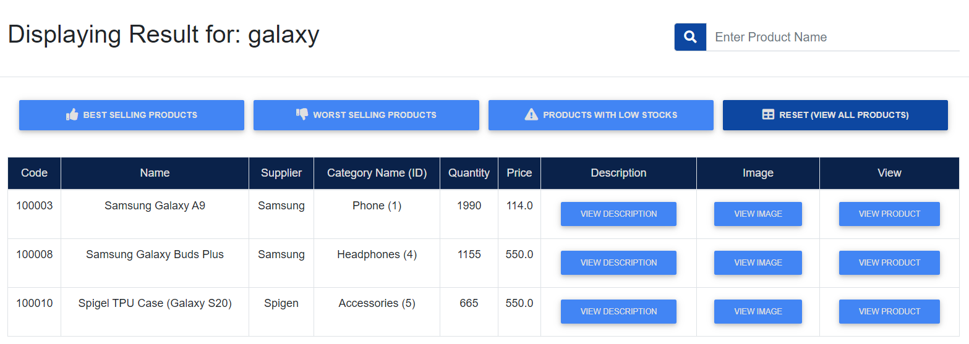
Admin Product Management (Search)
When a valid result is searched, it will display all product that consist of the word searched inside of the table
We achieve this using the SQL ‘LIKE’ Statement

Slide 36
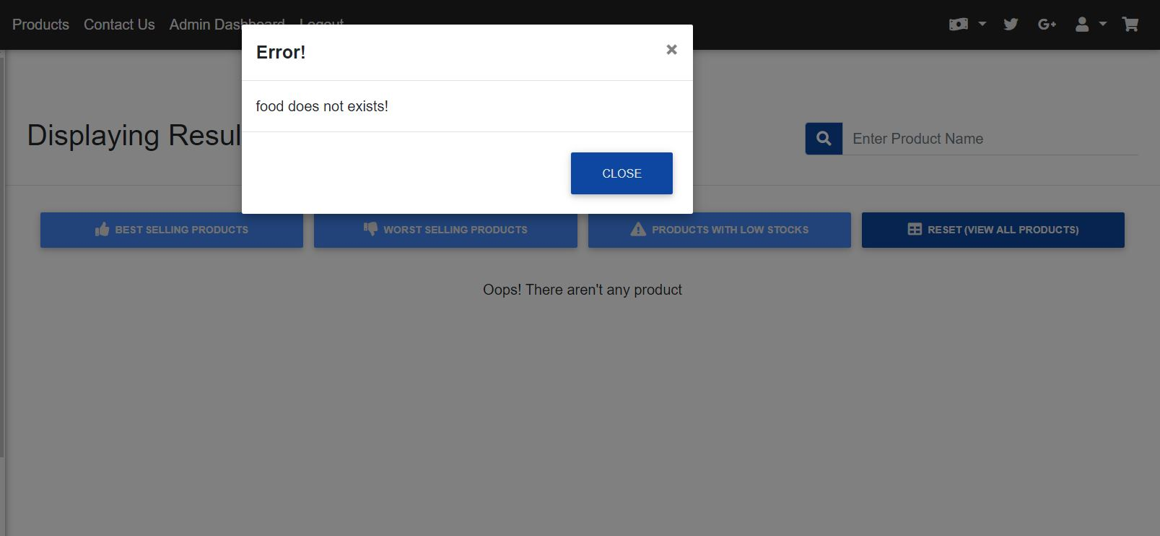
Admin Product Management (Get, Inquire & Report)
When a result is searched and it does not exists, it will display a modal informing that product does not exists

Slide 37
Admin Product Management (Update)
DB
Alerts controller of a particular event
Servlet 1: /adminUpdateProduct
Servlet 2:
/adminUpdateProductNoImage
JavaScript checks if there is any image uploaded before submit. If there is, it redirects to servlet 1 else it redirects to servlet 2.
Controller updates the respective model based on event called
Model: updateProductToDB.java
Method: updateProduct
Servlet gets the form parameters
CONTROLLER
Pings the database and then updates the product in the Database
Controller redirects back to the view with the updateCode to notify the admin on the update Status. View page is AdminUpdateProduct.jsp
VIEW
MODEL
Returns a boolean value to notify the controller of the update status
Depending on the status, the controller will redirect to the appropriate view
Sends Requests
Request: Update Product
User

Slide 38
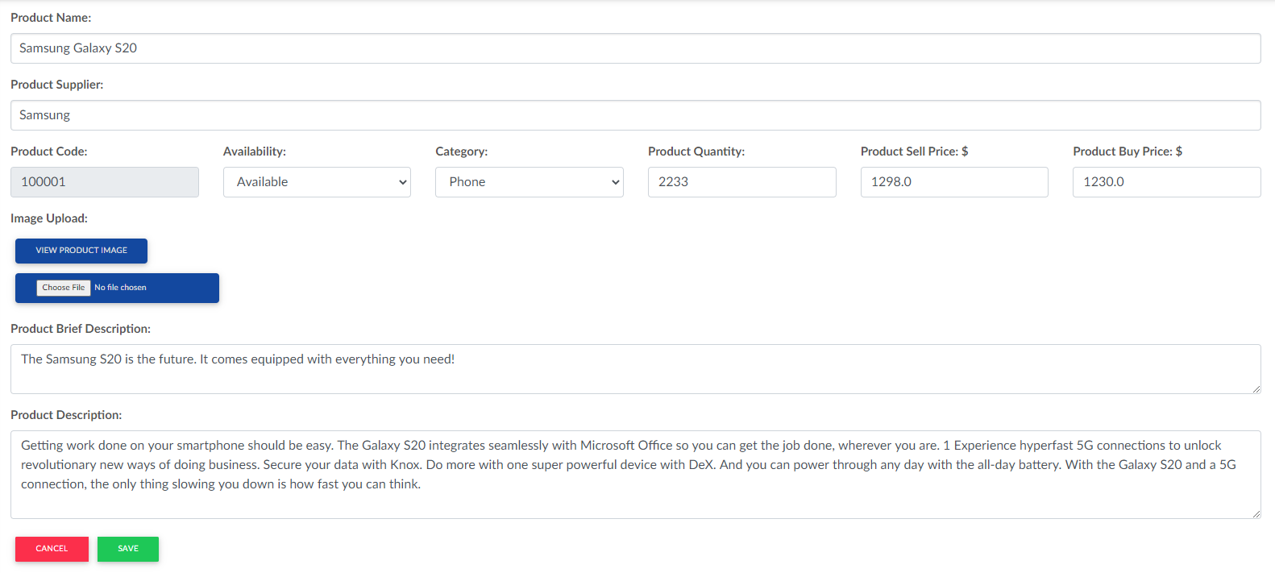
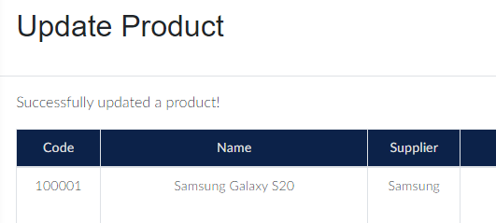
The JavaScript will check to see if there is any image uploaded. If there isn’t, the image will not be adjusted hence it is redirected to a different servlet. This is because the encoding type for the form is completely different.
Frontend will be updated to display the update status

Slide 39
Admin Product Management (Add Product)
DB
Step 2:
Controller updates the respective model based on event called
Model: addProductsToDB.java
Gets the data from what user has keyed in
STEP 1::
Alerts controller of a particular event
Redirects to ../../../../addNewProduct
Takes in the form values that are needed to create product. Such as productName, supplier, description and image etc
CONTROLLER
Step 3:
Pings the database and then adds the new user to database.
VIEW
MODEL
STEP 10:
Redirects to AdminDashboard.jsp
Step 4:
Returns a boolean value to notify the controller of the update status
Depending on the status, the controller will redirect to the appropriate view
Fills in form
Request: Add new Customer
User

Slide 40
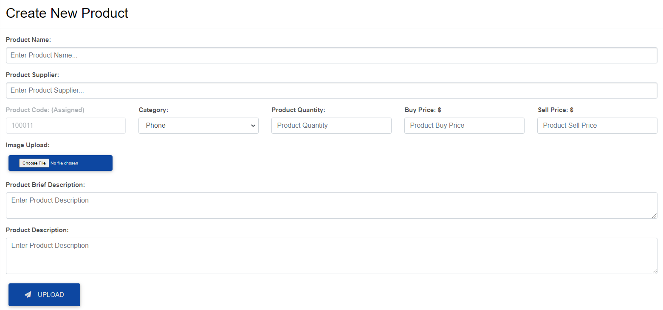
Admin Product Management (Create)
Image allows the administrators to upload image from their own devices to the website.

Slide 41
Admin Customer Management (Get, Inquire & Report)
DB
Controller updates the respective model based on event called
Model: getInquireReportCustomersFromDB.java
Parameter: page, pageSize, tableType, filterValue
Selects customer information from the database
CONTROLLER
Pings the database and then gets the data based on table type.Sets the UserDetails object via the getter/setter methods
Alerts controller of a particular event
Redirects to ../../../../getAllCustomers
Gets the parameter of the button value & page number to display correct table.
VIEW
MODEL
Controller re-renders the
View with latest Data received from the attribute and redirects back to AdminViewAllCustomers.jsp
During the model’s execution, it gathers data & stores in CustomersList array. This array is then returned at the end of execution.
CustomersList attribute is then update with the array returned from the model.
Sends Requests
Request: View All Customer / Inquire Products
User

Slide 42
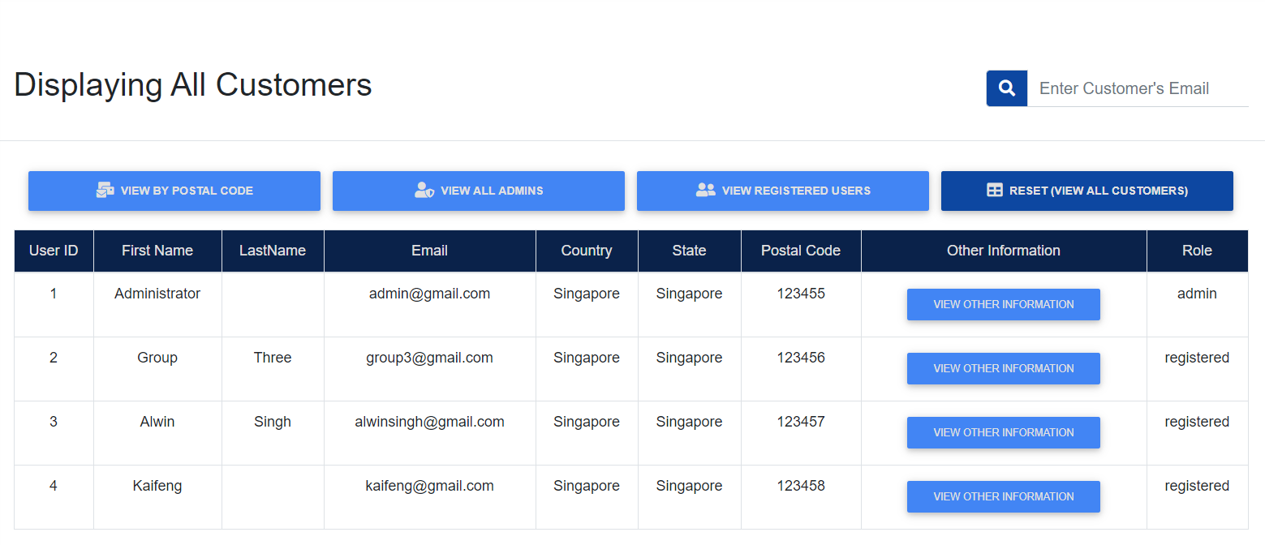
Admin Customer Management (Get, Inquire & Report)
Displays customer information
Button sets the type of table to display.
By default, table will be set to view all products.

Slide 43
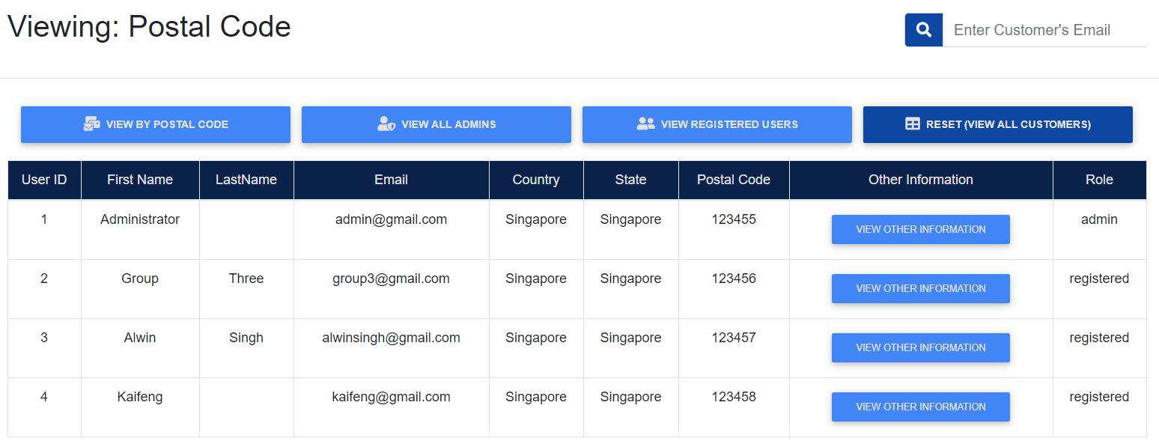
Admin Customer Management (Get, Inquire & Report)
When view by postal code is clicked, it displays the customers first by its country and state, then sort out by their postal code

Slide 44
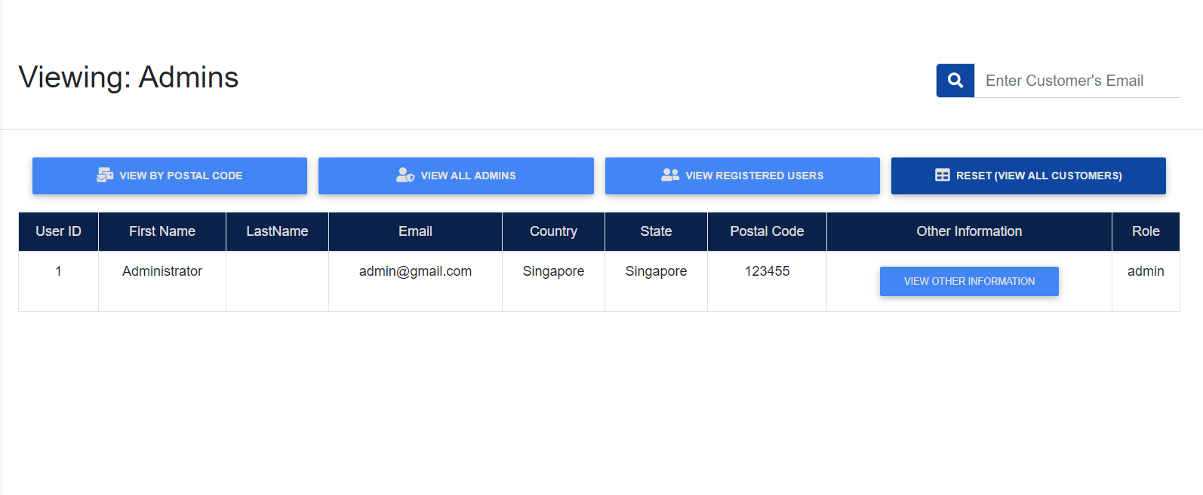
Admin Customer Management (Get, Inquire & Report)
When view all admins is clicked, it displays all user with admin status

Slide 45
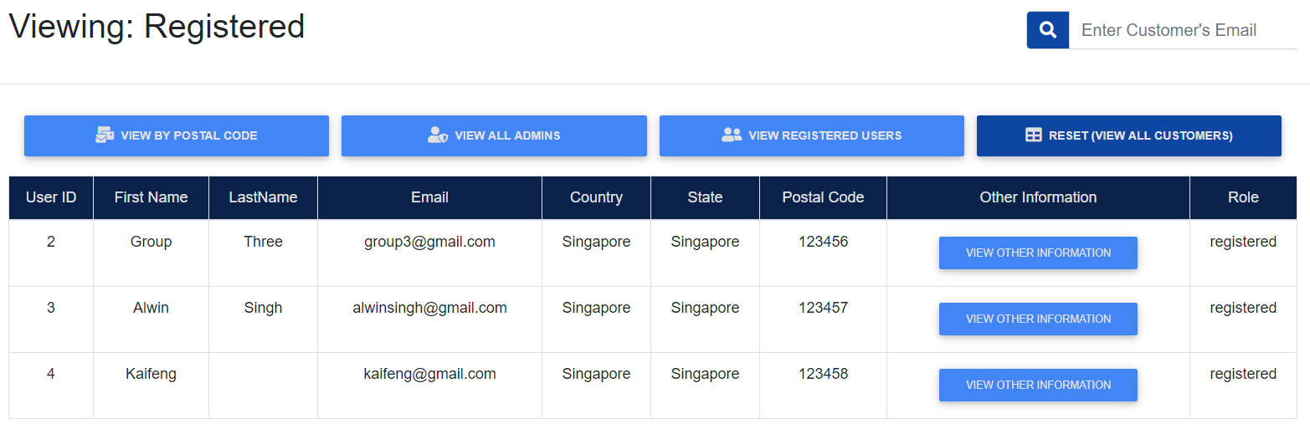
Admin Customer Management (Get, Inquire & Report)
When view all registered users is clicked, it displays all customer with registered status

Slide 46
Admin Customer Management (Get User Type)
DB
Step 2:
Controller updates the respective model based on event called
Model: userType.java
Selects the available roles from the database
CONTROLLER
STEP 1:
Alerts controller of a particular event
Redirects to ../../../../getUserType
Step 3:
Pings the database and then gets the data. Sets the UserDetails getter/setter
VIEW
MODEL
STEP 5:
Redirects to AdminCreateCustomer.jsp
Step 4:
Gathers data & store in userTypeList array.
userTypeList attribute is then set with the array.
Sends Requests
Request: Add new Customer
User

Slide 47
Admin Customer Management (Add Customer)
DB
Step 7:
Controller updates the respective model based on event called
Model: addNewCustomerToDB.java
Gets the data from what user has keyed in
STEP 6:
Alerts controller of a particular event
Redirects to ../../../../addNewCustomer
Takes in the form values that are needed to create customer. Such as firstname, lastname, phone and postalcode, etc
CONTROLLER
Step 8:
Pings the database and then adds the new user to database.
VIEW
MODEL
STEP 10:
Redirects to AdminDashboard.jsp
Step 9:
Returns the insert status
Fills in form
Request: Add new Customer
User

Slide 48
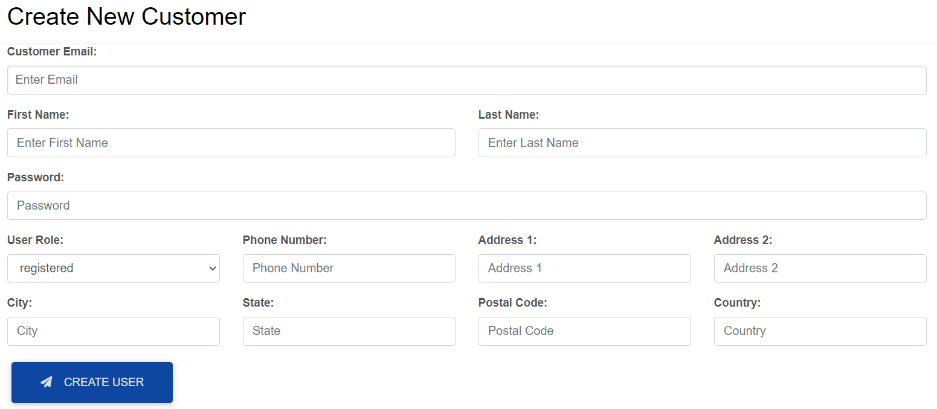
Admin Customer Management (Create)
Displays create customer form for admin to create new user.
Admin will fill up the information and click create user

Slide 49
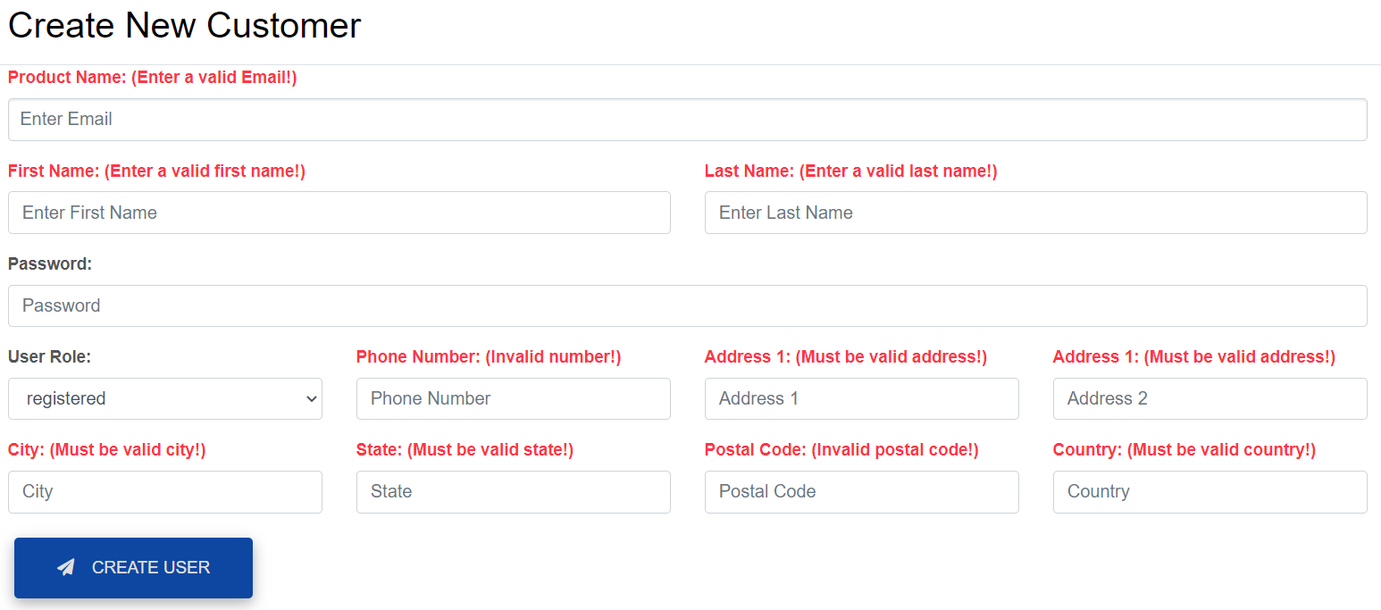
Admin Customer Management (Get, Inquire & Report)
If user attempts to submit an empty form

Slide 50
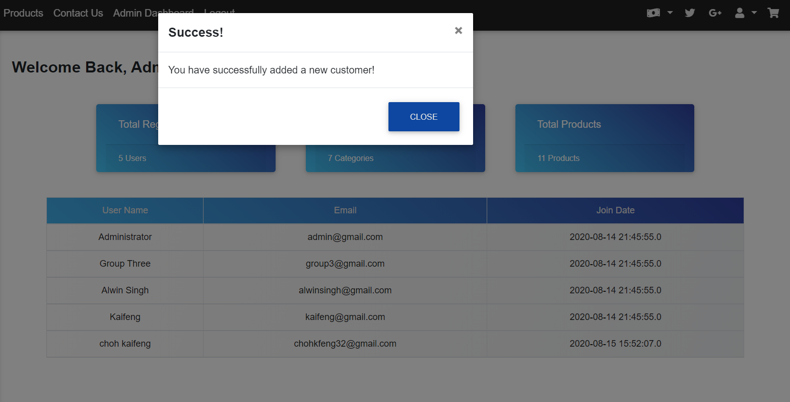
Admin Customer Management (Get, Inquire & Report)
If new user is added successfully, it will display a modal informing that a new customer is added.

Slide 51
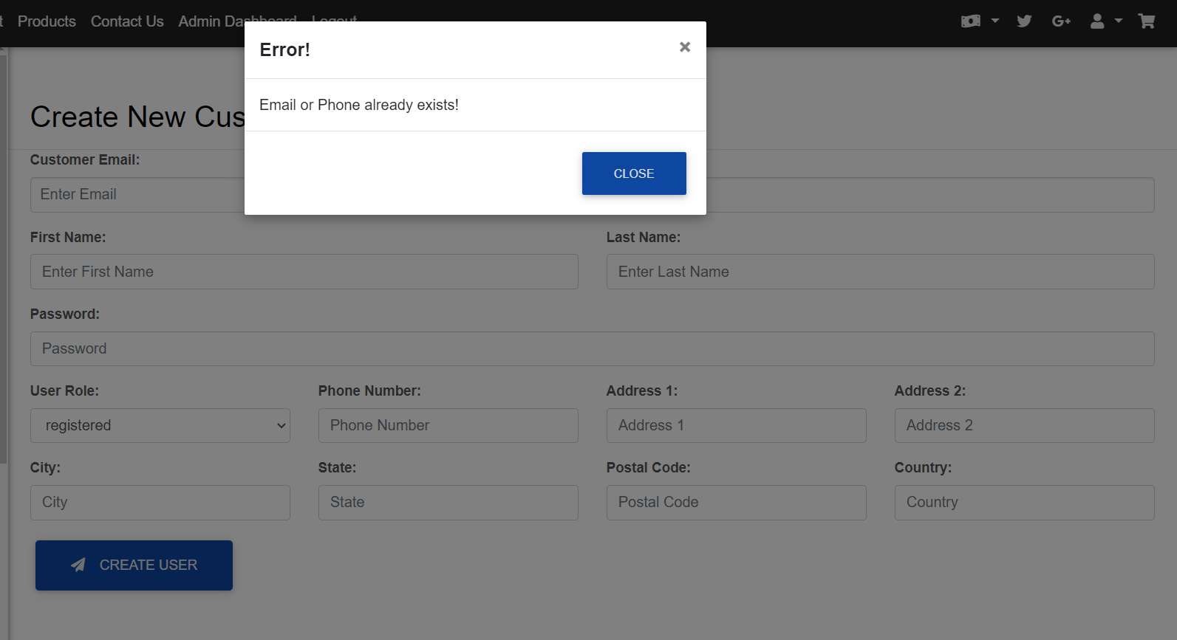
Admin Customer Management (Get, Inquire & Report)
If user with the same email or phone already exists, then it will not add into the database.

Slide 52
Admin Customer Management (Update Customer List)
DB
Step 2:
Controller updates the respective model based on 2 event called
Model: userType.java and getAllCustomersFromDB.java
Selects the roles and customers from the database
CONTROLLER
STEP 1:
Alerts controller of a particular event
Redirects to ../../../../updateCustomerList
Step 3:
Pings the database and then gets the 2 data.
VIEW
MODEL
STEP 5:
Redirects to AdminEditCustomer.jsp
Step 4:
Gathers data & store in userList & userTypeList array.
userList & userTypeList attribute is then set with the array.
Sends Requests
Request: Update Customer
User

Slide 53
Admin Customer Management (Update Customer)
DB
Step 7:
Controller updates the respective model based on event called
Model: updateCustomerFromDB.java
Gets the data from what user has keyed in
STEP 6:
Gets the ID of the user which was pressed
Redirects to ../../../../updateCustomer
Takes in the form values that are needed to update customer. Such as firstname, lastname, phone and postalcode, etc
CONTROLLER
Step 8:
Pings the database and update the user information. Sets the UserDetails getter/setter
VIEW
MODEL
STEP 10:
Redirects to ../../../../updateCustomerList to update the list and returns to AdminUpdateCustomer.jsp
Step 9:
Gathers data & store in
user object.
userData is then set with the object.
Fills in form
Request: Edit Customer
User

Slide 54
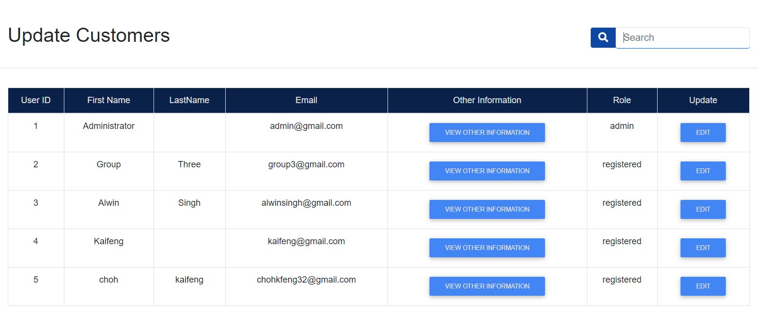
Admin Customer Management (Update Customer List)
Displays the list of customers and their roles and informations.

Slide 55
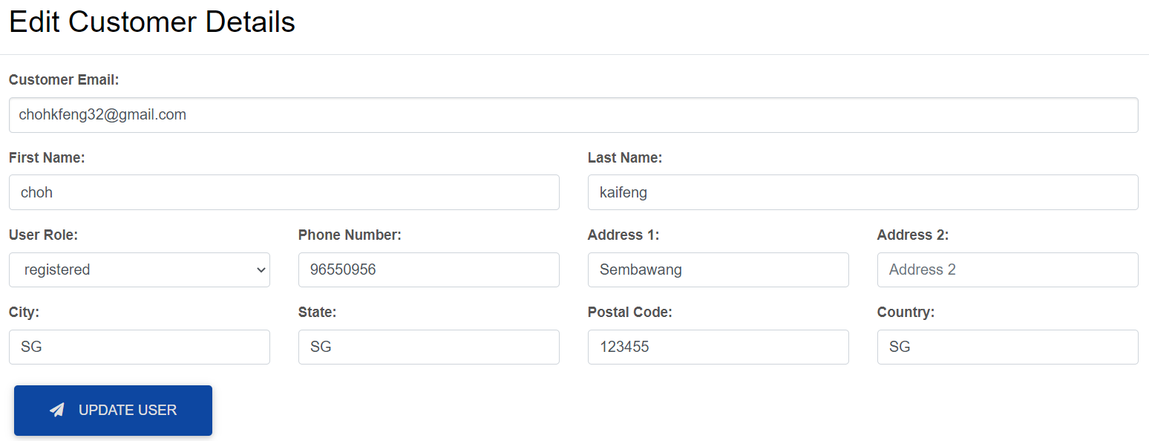
Admin Customer Management (Edit Customer)
Customer with the id clicked will have information prefilled for them the admin to updated

Slide 56
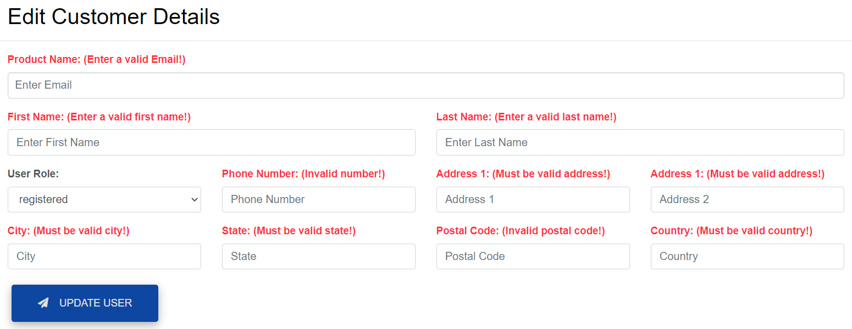
Admin Customer Management (Edit Customer)
If user tries to submit and empty form

Slide 57
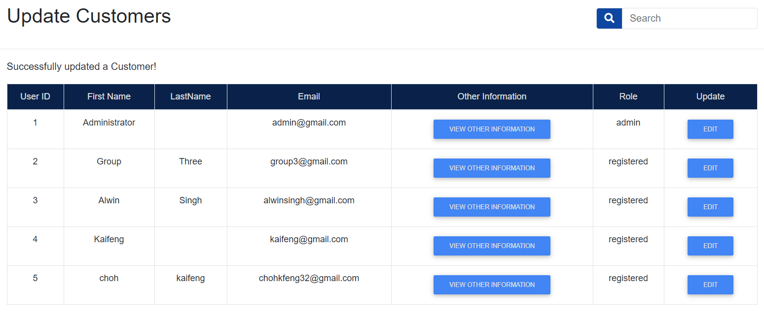
Admin Customer Management (Successful Edit)
If customer is updated successfully, a message will display to inform of successful update.

Slide 58
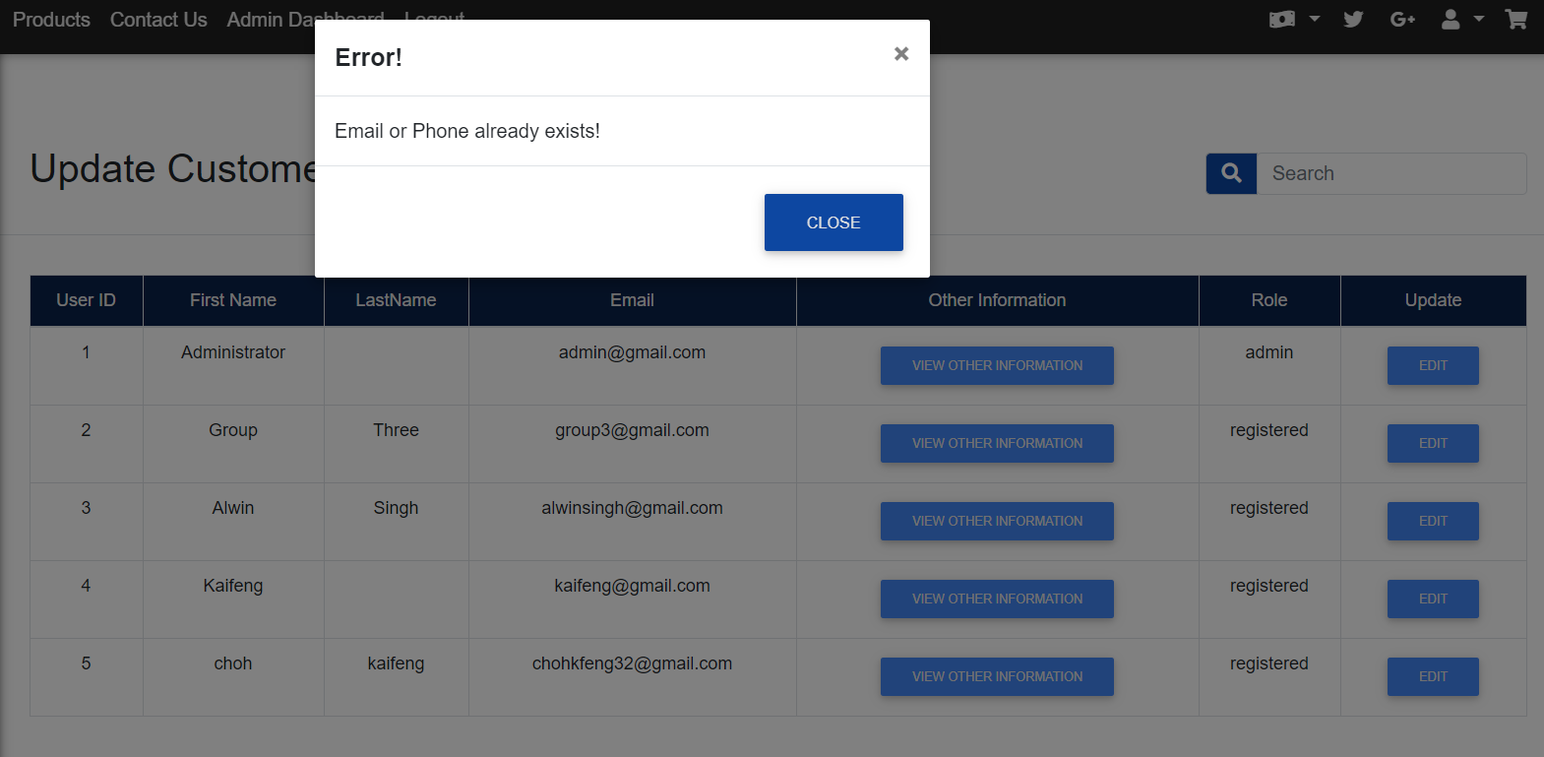
Admin Customer Management (Unsuccessful Edit)
If customer is updated unsuccessfully, a modal will display to inform of unsuccessful update.

Slide 59
Admin Customer Management (Delete)
DB
Step 2:
Controller updates the respective model based on 2 event called
Model: getAllCustomersFromDB.java
Selects the customers from the database
CONTROLLER
STEP 1:
Alerts controller of a particular event
Redirects to ../../../../deleteCustomerList
Step 3:
Pings the database and then gets the data.
VIEW
MODEL
STEP 5:
Redirects to AdminDeleteCustomer.jsp
Step 4:
Gathers data & store in userList array.
userList attribute is then set with the array.
Sends Requests
Request: Delete Customer
User

Slide 60
Admin Customer Management (Delete)
DB
Step 7:
Controller updates the respective model based on event called
Model: deleteCustomerFromDB.java
Delete the data from the one user has chosen to delete
STEP 6:
Gets the ID of the user which was pressed
Redirects to ../../../../deleteCustomer
Takes in a hidden input that stores the customer’s database index
CONTROLLER
Step 8:
Pings the database and delete the user information.
VIEW
MODEL
STEP 10:
Redirects to ../../../../deleteCustomerList to update the list and returns to AdminDeleteCustomer.jsp
Step 9:
Sets delCustomer
parameter as true if its successfully deleted
Clicks on delete button
Request: Delete Customer
User

Slide 61
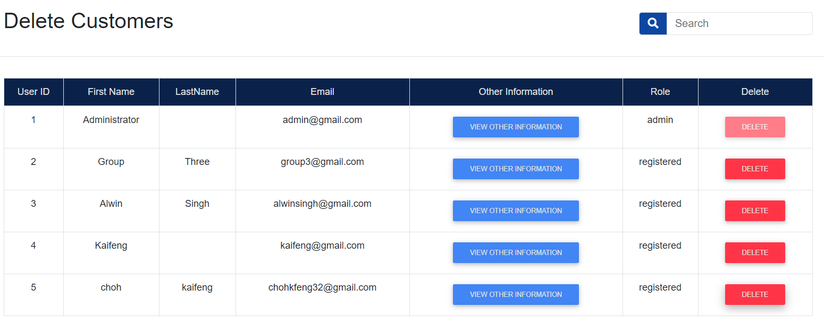
Admin Customer Management (Delete Customer List)
Displays the list of customers and their roles and informations.

Slide 62
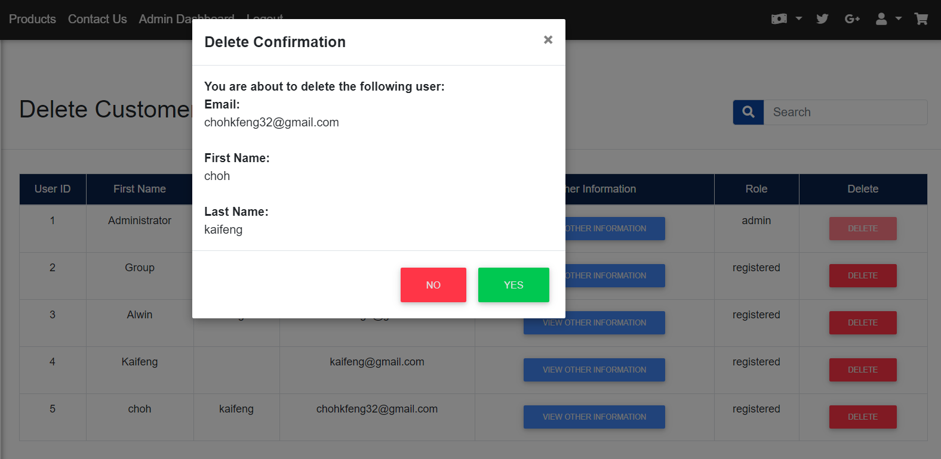
Admin Customer Management (Delete Customer)
When the delete button is clicked, a modal shows up to confirm user’s decision

Slide 63
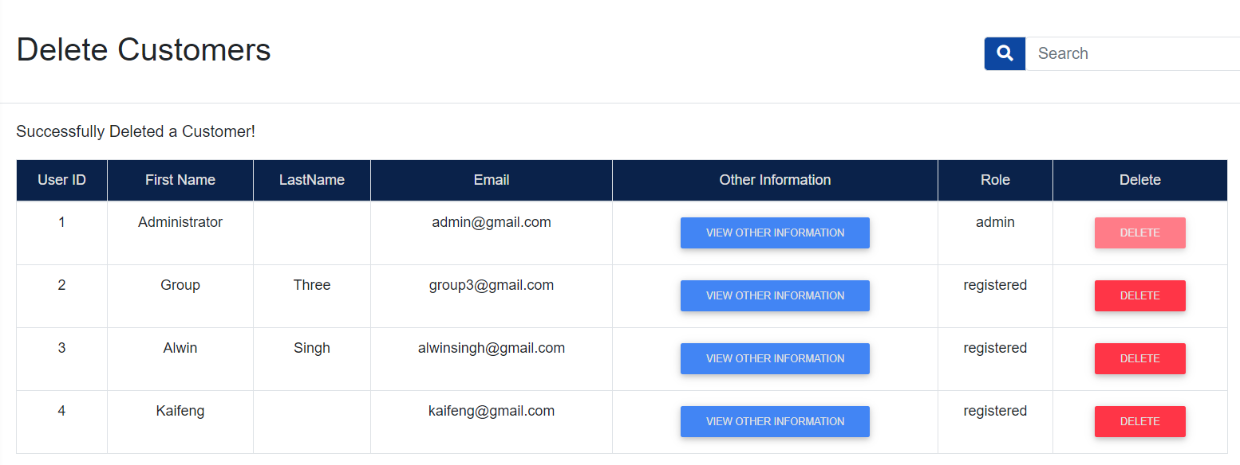
Admin Customer Management (Delete Customer)
If yes is clicked, user will be deleted and redirected to AdminDeleteCustomer.jsp with a message indicated successful deletion of the user

Slide 64
Admin Order Management (View All)
allProducts & orderDetails object is used
DB
Controller updates the respective model based on event called
Model: UserOrdersFromDB
Method:
adminGetAllOrdersFromDB
adminGetOrderItemsFromDB
Alerts controller of a particular event
Redirects to
/addToShoppingCart servlet
Parameter:
User Session (UserDetails object)
CONTROLLER
Pings the database and then gets the latest data of all orders on the site
After retrieving the updated arrayLists from the model, the controller then assigns it to the session named ‘adminOrdersList’ and ‘adminOrderItemsList’.
VIEW
MODEL
Controller re-renders the
View with latest Data
Method #1: This method pings the database and begins to load OrderDetails object into an OrderDetails ArrayList. End of execution, this is returned to the Controller.
Method #2: This method pings the database as well and loads the allProducts object into an allProducts ArrayList. End of execution, this is returned to the controller.
Sends Requests
Request: View All Orders
User

Slide 65
Admin Order Management (Inquiry & Reporting)
allProducts & orderDetails object is used
DB
Controller updates the respective model based on event called
Model: UserOrdersFromDB
Method:
adminorderReportsFromDB
adminGetOrderItemsFromDB
Alerts controller of a particular event
Redirects to
/inquireReportOrders servlet
Parameter:
User Session (UserDetails object)
Table type
Filter value
CONTROLLER
Pings the database and then gets the latest data of orders on the site that matches the desired inquiry
After retrieving the updated arrayLists from the model, the controller then assigns it to the session named ‘adminOrdersList’ and ‘adminOrderItemsList’.
VIEW
Method #1: This method takes in the table type and filter value. Based on what is passed in, it then assigns a SQL query for that inquiry / reporting type. It then loads an array of orderDetails object and returns it at the end
Method #2: This method pings the database as well and loads the allProducts object into an allProducts ArrayList. End of execution, this is returned to the controller.
MODEL
Controller re-renders the
View with latest Data
The table type is dependent on the button
that is pressed (Gets the button value)
Current table / inquiry types: PFO, OBM, OBI
The filter value is dependent on the
inquiry type, certain inquiries have
specific input hence the filter value
is used in those cases.
(E.g. Month, Stock,etc)
Sends Requests
Request: Order Inquiry / Reporting
User

Slide 66
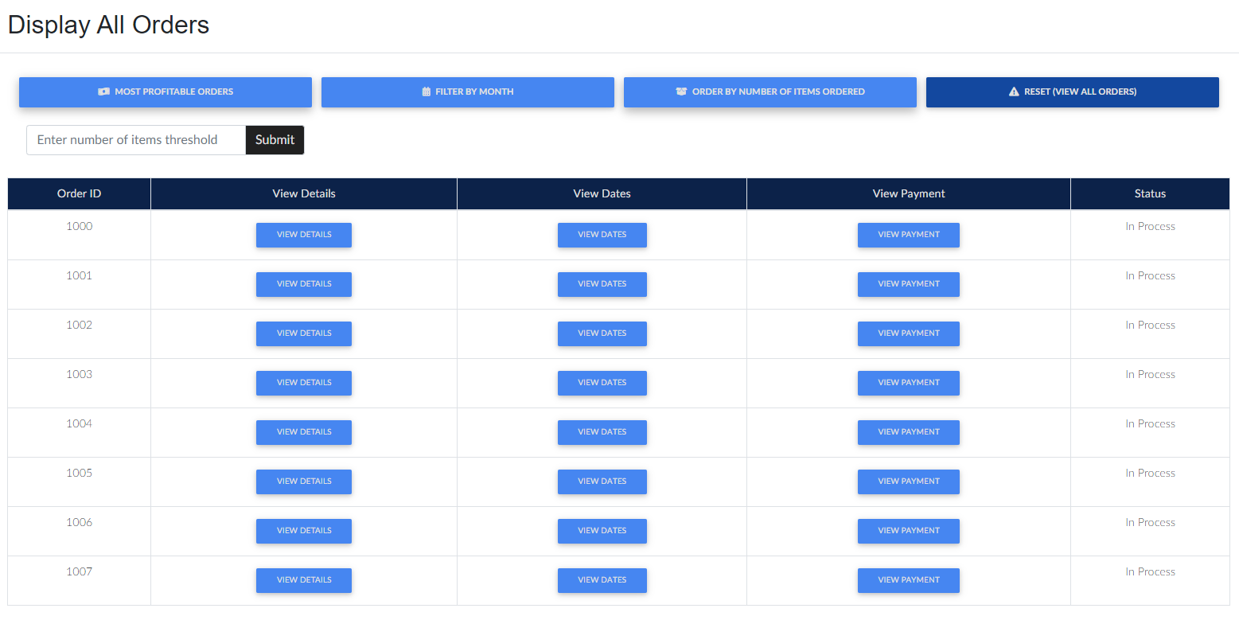
This header’s text changes according to the filter type
The buttons in red are those that require no specific filtering input and upon click, it will redirect to the servlet.
The buttons in green are those that require specific filtering and upon click it will request for a input, on clicking ‘submit’, it will redirect to the servlet.

Slide 67
ADVANCE FEATURES
MVC

Slide 68
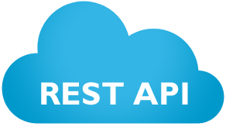
Currency Converter
shoppingCart, allProducts & UserDetails object is used
DB
Controller updates the respective model based on event called after calling the API
Model: getAllProductsFromDB
Method:
1. retrieveProducts
API returns the JSON data
Alerts controller of a particular event
Redirects to
/CurrencyConverter servlet
Parameter:
User Session (UserDetails object)
CONTROLLER
Controller Updates;
Sets user’s currency rate
as a session object
Updates the user session object / cookie with user’s currency
Sets the allProducts arrayList from
the model into a session ‘productList’
If there is a existing shoppingCart, it updates the pricing with
the new currency
Pings the database which then gets the latest data of all products on the site
VIEW
MODEL
Controller re-renders the
View with latest Data
Method #1: This method pings the database and begins to load allProducts object into an allProducts arrayList which in the end is then returned to the controller.
Sends Requests
Request: Change Currency / Login
Whenever a user logs in or changes his/her currency, it will utilise this MVC.
The user’s currency is set in the Database and will be updated when he/she logs out hence on the next log in this MVC is used to ensure the pricing meets the user’s currency defined in the Database from the user’s last session.
User

Slide 69
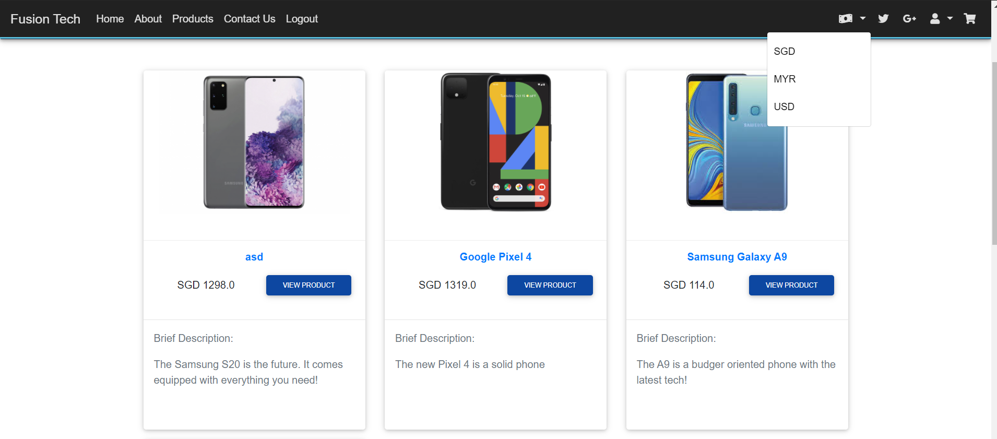
Admin Currency Converter
When clicked on the dollar icon, the user can choose between Singapore Dollar, Malaysian Ringgit and United States Dollars.

Slide 70
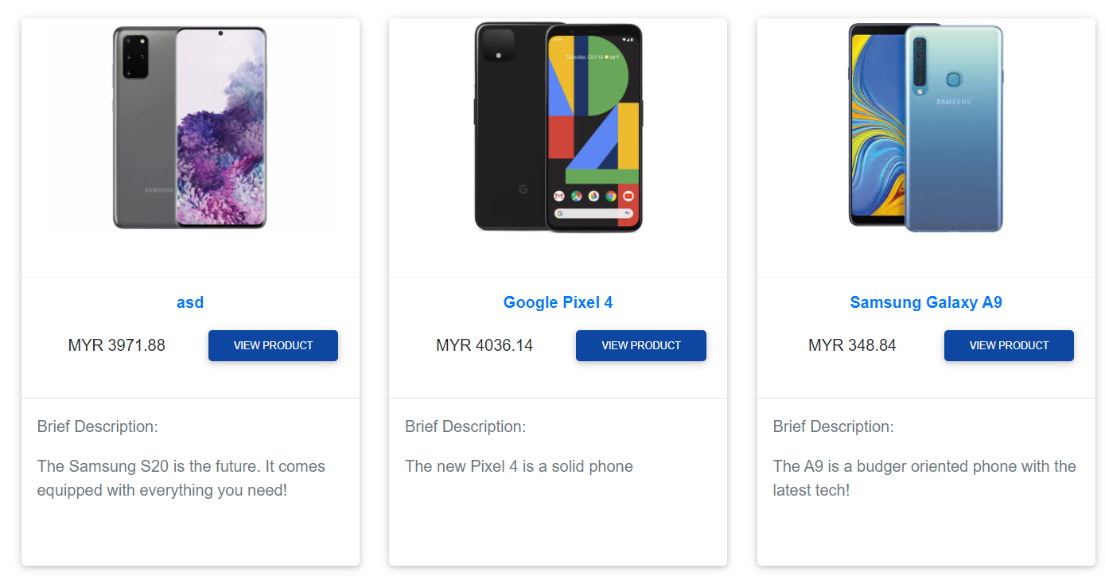
Admin Currency Converter
When the user clicks on MYR, the currency and the value of the product converts from SGD to MYR

Slide 71
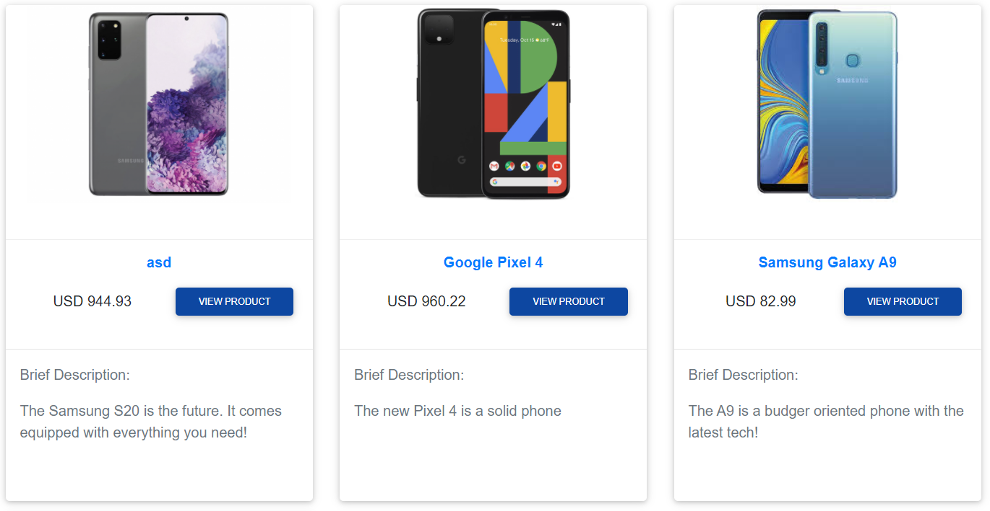
Admin Currency Converter
When the user clicks on USD, the currency and the value of the product converts from MYR to USD

Slide 72


Admin Currency Converter
The currency is persistent to each order.
The shopping cart is dynamic, it’s currency is in sync with the user’s currency of choice for that session. Same for the products page, etc.

Slide 73
Logout
shoppingCart, allProducts & UserDetails object is used
DB
Controller updates the respective model based on event called after calling the API
Model: updateCustomerFromDB
Method:
1. updateCustomerCurrency
API returns the JSON data
Alerts controller of a particular event
Redirects to
/addToShoppingCart servlet
Parameter:
User Session (UserDetails object)
CONTROLLER
Pings the database which updates the customer’s currency
Controller Updates;
Invalidates the session
Redirects to the respective page
VIEW
MODEL
Controller re-renders the
View with latest Data
Method #1: This method takes in the user’s currency through the session’s (UserDetails object) getter method which retrieves the user’s currency. It is then passed into the method which then pings the database, updating the customer’s currency.
The method returns a boolean value to notify the Controller of the update status.
Sends Requests
Request: Logout
User

Slide 74
Admin Customer Management (Search Customer)
DB
Controller updates the respective model based on event called
Model: searchCustomerFromDB.java
Selects customer information from the database
CONTROLLER
Alerts controller of a particular event
Redirects to ../../../../searchCustomer
Gets the user’s input from search input
Pings the database and then gets the data base on value searched
VIEW
MODEL
Controller re-renders the
View with latest Data
Redirects back to AdminViewAllCustomers.jsp
Gathers data & store in customersList array.
customersList attribute is then set with the array.
Sends Requests
Request: Search for Customer
User

Slide 75
Admin Customer Management (Get, Inquire & Report)
When searched, value keyed in will be taken in and sent to be searched by the database

Slide 76

Admin Customer Management (Get, Inquire & Report)
When a valid result is searched, it will display all customer that consist of the word searched inside of the table

Slide 77

Admin Customer Management (Get, Inquire & Report)
When a result is searched and it does not exists, it will display a modal informing that product does not exists

Slide 78
THANK YOU

